Slide 1
CAMCOS Center for Applied Mathematics, Computation and Statistics
Team Sponsor – Jeff Scargle (NASA)
CAMCOS director and Faculty Supervisor– Slobodan Simić

Slide 2
The Geometry and Topology of the Cosmic Web
CAMCOS NASA team: Hái Nguyên Âu, Joey Fitch, David Goulette, Matthew Litrus, Jian-Long Liu, Brandon Morrison, and Catherine Parayil

Slide 3
Introduction
Notes:
My name is Catherine Parayil and I’m pleased to present you our findings on the Geometry and Topology of the cosmic web
We have a lot to share with you today, so I’ll jump right into introducing our problem.

Slide 4
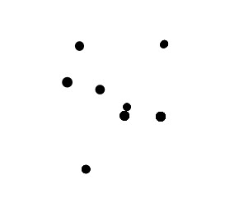
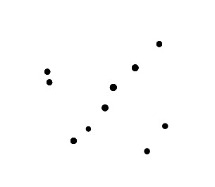
What shapes do you see?
Notes:
Before we look specifically at our data, let’s begin by examining a simpler, but related problem. Given a set of points, how can we determine the geometry and topology of those points? What shapes do you see? What if I told you that these dots actually formed letters (obviously with some dots missing)? With that knowledge, would you be able to identify the letters that these points form?

Slide 5
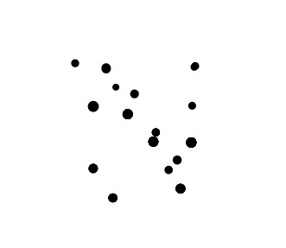
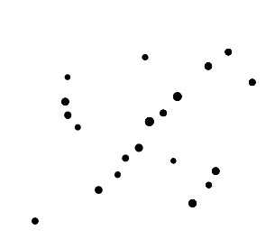
What shapes do you see?
Notes:
If we had more points available, it would be easier to determine which shapes they are.

Slide 6
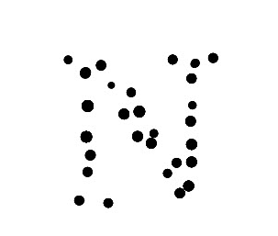
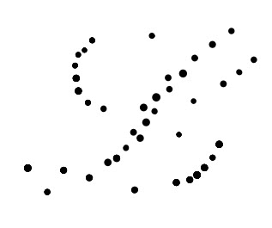
What shapes do you see?
Notes:
Eventually, our eyes are able to identify the shapes. But how do we teach a computer to recognize the same shapes that we can identify by eye?

Slide 7
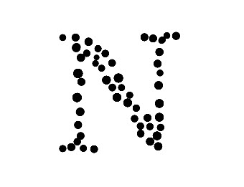
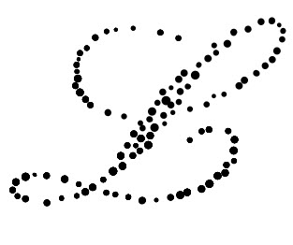
What shapes do you see?
Notes:
We want to be able to say which points should be connected to one another. We want to identify areas of thick point distributions and classify them separately from thin distributions. We want to see how many holes are in the data (the N has no holes and the L has two)

Slide 8
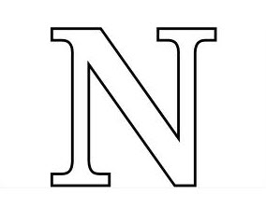

What shapes do you see?
Notes:
It helps to have a textbook answer to refer to, but in the case of our data, we only have one universe and only one point distribution. We do not have a correct answer to refer to, so our process is different from supervised learning.

Slide 9
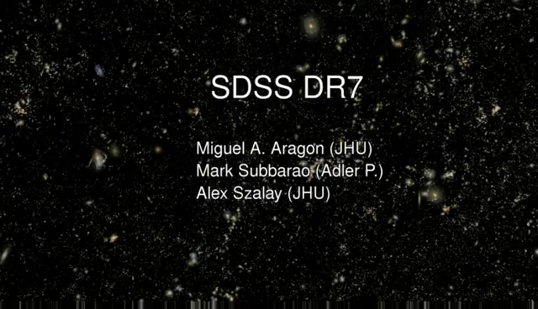
Sloan Digital Sky Survey
Notes:
The data we are working with is a subset of the Sloan Digital Sky Survey, which is data collected from the 2.5 m telescope at the Apache Point Observatory in New Mexico. Each object you see here is an entire galaxy like the milky way, composed of hundreds of billions of stars like our sun. As we fly through the data, you might get a sense of structure – what some call the “cosmic web”. There appear to be over-dense and under-dense regions. Our goal is to classify those regions.

Slide 10
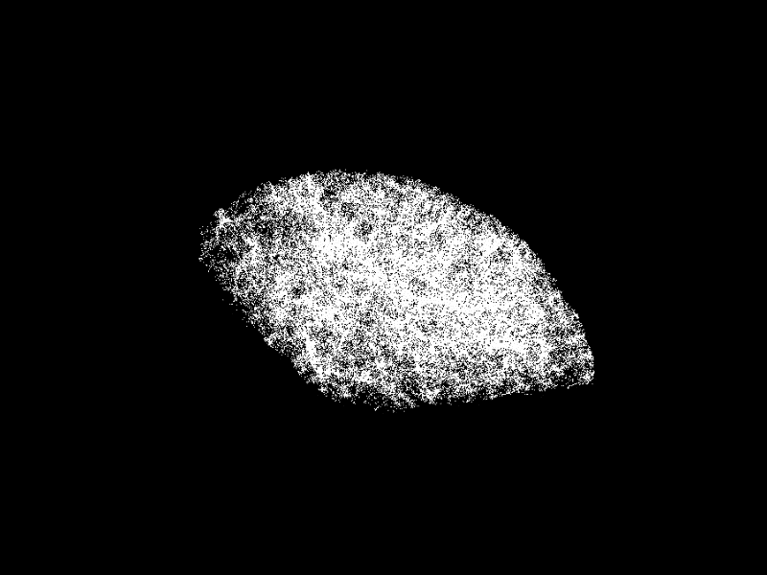
Sloan Digital Sky Survey
Notes:
Here is the particular subset of the SDSS which we are working with. Our data consists of a survey of about 134,000 galaxies. Each point in the data is an entire galaxy, similar to our Milky Way – each point here consists of hundreds of billions of stars. (PAUSE) We make a lot of basic assumptions – that the masses are all equal, and relatively close to us. These points represent the brightest galaxies in a slice of the sky. With your eye, you may be able to identify places where galaxies are grouped together in areas of high point density. There are also areas of low density. Our problem is to characterize the geometry and topology of this data set – to identify structures. It can be especially challenging to identify these structures in three dimensions. (UNPAUSE) For the sake of visualization, most of our examples will be shown on flattened thin slices of the data. Here you can see one such thin slice. If we flatten this slice, we can work with the resulting structures in 2 dimensions. Perhaps your eye can identify some structure here. We now need to group structures together and classify them.

Slide 11
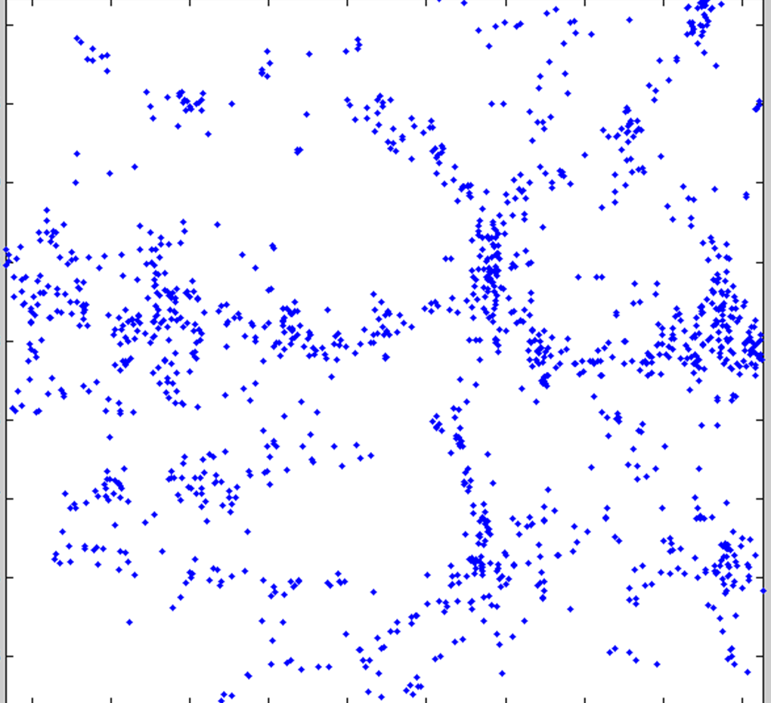
Goals
We want to find structures in the galaxy distribution
Partition the space
Grouping
Classification of structures
a. Clusters b. Filaments c. Voids
Notes:
Ultimately, our goal is to identify structures in the galaxy distribution. First, we need to partition the space, then group points together into classes, and classify the resulting structures. (CLICK) Galaxies tend to group together and form clusters. We will classify areas of highest point density as clusters. (CLICK) There are also more extended structures such as filaments and walls. Filaments are primarily 1d – long and tubular structures. Walls are like sheets of galaxies, forming 2d structures. (CLICK) The large, mostly empty regions are termed “voids”.

Slide 12
Goals
We want to find structures in the galaxy distribution
Partition the space
Grouping
Classification of structures
a. Clusters b. Filaments c. Voids
Notes:
Ultimately, our goal is to identify structures in the galaxy distribution. First, we need to partition the space, then group points together into classes, and classify the resulting structures. (CLICK) Galaxies tend to group together and form clusters. We will classify areas of highest point density as clusters. (CLICK) There are also more extended structures such as filaments and walls. Filaments are primarily 1d – long and tubular structures. Walls are like sheets of galaxies, forming 2d structures. (CLICK) The large, mostly empty regions are termed “voids”.

Slide 13
Goals
We want to find structures in the galaxy distribution
Partition the space
Grouping
Classification of structures
a. Clusters b. Filaments c. Voids
Notes:
Ultimately, our goal is to identify structures in the galaxy distribution. First, we need to partition the space, then group points together into classes, and classify the resulting structures. (CLICK) Galaxies tend to group together and form clusters. We will classify areas of highest point density as clusters. (CLICK) There are also more extended structures such as filaments and walls. Filaments are primarily 1d – long and tubular structures. Walls are like sheets of galaxies, forming 2d structures, which are difficult to picture here in the flattened data. (CLICK) The large, mostly empty regions are termed “voids”.

Slide 14
Goals
We want to find structures in the galaxy distribution
Partition the space
Grouping
Classification of structures
a. Clusters b. Filaments c. Voids
Notes:
Ultimately, our goal is to identify structures in the galaxy distribution. First, we need to partition the space, then group points together into classes, and classify the resulting structures. (CLICK) Galaxies tend to group together and form clusters. We will classify areas of highest point density as clusters. (CLICK) There are also more extended structures such as filaments and walls. Filaments are primarily 1d – long and tubular structures. Walls are like sheets of galaxies, forming 2d structures. (CLICK) The large, mostly empty regions are termed “voids”.

Slide 15
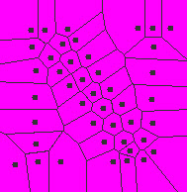
Partition the Space
Cells surround data points partitioning the space
Notes:
In order to group points together, we need to identify neighboring points. Our first task is partitioning the data space. To do so, we surround the points with cells.

Slide 16
Finding Groups
Notes:
Then we need to find groups through clustering the data points. In many of the algorithms we tried, we recover a large quantity groups consisting of few points

Slide 17
Finding Groups
Notes:
To get a more global sense of the data, we need to group the small clusters together into structures which share similar characteristics.

Slide 18
Classify Structures
Feet
Legs
Body
Notes:
At that point, we can classify the structures we have found by whether they are primarily 1d, 2d, or 3d. In this case, we would say both the feet and legs of the N are mostly 1d and the diagonal is mostly 2d.

Slide 19
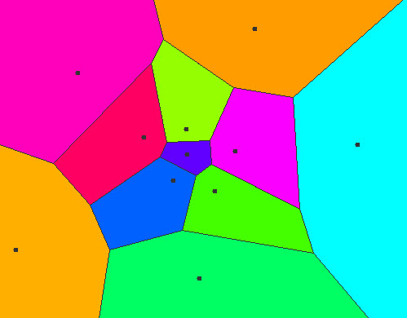
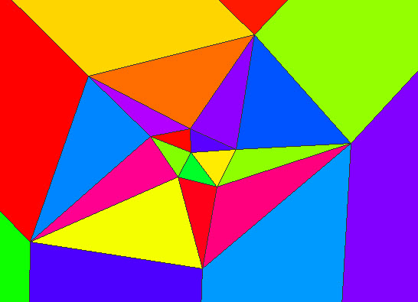
Voronoi and Delaunay
Voronoi – colorful polygons surround black galaxies
Delaunay – corners of triangles are galaxies, edges connect neighbors
Notes:
In order to define the density of a point in a point cloud, we first tessellate our data using a Voronoi tessellation. A Voronoi cell consists of all the points in the plane which are closer to the galaxy in its cell than to any other galaxy. An edge of a Voronoi cell are points in space equidistant to two galaxies and a vertex is a point in space equidistant to three galaxies. Notice that in regions of high point density, the Voronoi cells have small area. In the Delaunay triangulation, each vertex is a galaxy. A Delaunay triangulation puts edges connecting the neighboring galaxies.

Slide 20
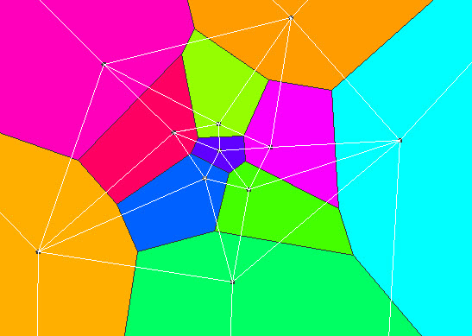
Voronoi and Delaunay are Dual
Notes:
In graph theory, the Voronoi tessellation is the dual graph of the Delaunay tessellation. (CLICK) When two Voronoi cells border each other, there is an (CLICK) edge between them in the Delaunay tessellation. In the Voronoi diagram, every galaxy is surrounded by a polygonal cell. In the Delaunay triangulation, every galaxy is the vertex of a triangle.

Slide 21
Voronoi Cells
Notes:
In graph theory, the Voronoi tessellation is the dual graph of the Delaunay tessellation. (CLICK) When two Voronoi cells border each other, there is an (CLICK) edge between them in the Delaunay tessellation. In the Voronoi diagram, every galaxy is surrounded by a polygonal cell. In the Delaunay triangulation, every galaxy is the vertex of a triangle.

Slide 22
Delaunay Edge
Notes:
In graph theory, the Voronoi tessellation is the dual graph of the Delaunay tessellation. (CLICK) When two Voronoi cells border each other, there is an (CLICK) edge between them in the Delaunay tessellation. In the Voronoi diagram, every galaxy is surrounded by a polygonal cell. In the Delaunay triangulation, every galaxy is the vertex of a triangle.

Slide 23
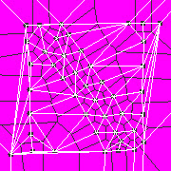
Defining Neighborhoods
Cells surround points
White edges connect points
Notes:
Here you can see the Voronoi and Delaunay tessellations applied to our letter N. In the Delaunay tessellation on the right, the white edges connect neighboring points. Some of these adjacencies are intuitive, but some seem unnatural. We may not wish for a point in the body of the N to be a neighbor of a point in the leg of the N. We will address this problem later in the talk.

Slide 24
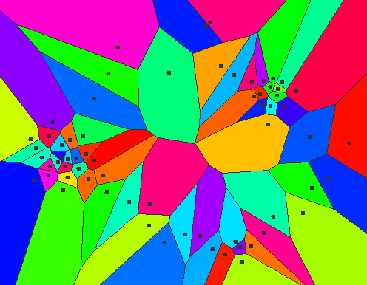

Point Density
We define point density as
$$ρ=\frac{Mass}{Volume}$$
$$ρ=\frac{1}{Voronoi cell volume}$$
Notes:
In order to identify areas of high and low density in the data set, we need to define a density function. In physics, density is the ratio of mass to volume. Since we assume the galaxy masses are all equal, we assign them a mass of 1 and divide by the volume of the Voronoi cell surrounding the galaxy. Note that our data is 3d, so our voronoi cells have volume, unlike the areas portrayed here in 2d. Also notice that points in regions of high density have small voronoi cells, while points in regions of lower density have much larger cells.

Slide 25
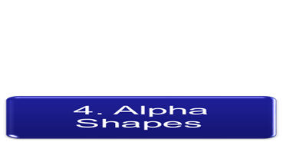
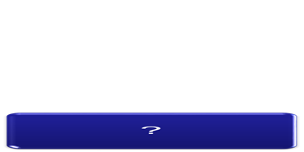
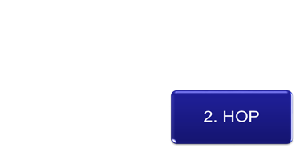
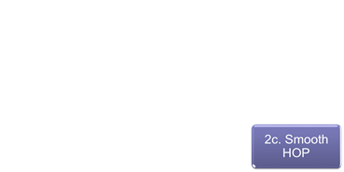
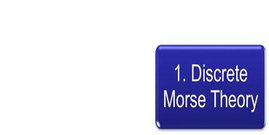
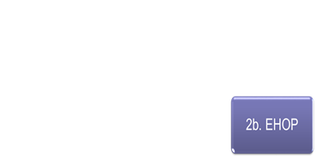
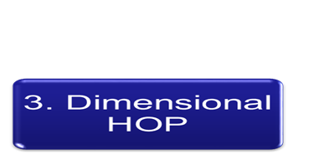
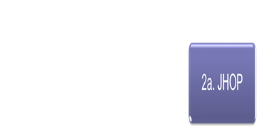
What We Tried
1. Discrete Morse Theory
1. Discrete Morse Theory
Notes:
In our efforts to partition the data, group small clusters, and classify structures, we tried many different algorithms. Our goal in each case was the same: to determine a computationally simple algorithm with few parameters to identify structures. Initially, we examined Discrete Morse Theory, and then proceeded with variations of HOP, such as JHOP, EHOP, and smooth HOP. We tried to get the same results from Discrete Morse Theory using a version of HOP called Dimensional HOP and then we looked at alpha shapes and combined them with HOP for a potential new technique to analyze the cosmic web. We will begin by discussing Discrete Morse Theory.

Slide 26
Morse Theory

Slide 27
Morse Theory
Morse theory finds the topology (or shape) of a smooth space by studying smooth functions on that space
To do that, Morse theory uses information about critical points of the smooth function (maxima, minima, and saddles)
Notes:
Morse theory strives to identify the topology or shape of a space by studying a Morse function (or smooth underlying function) on that space. To do that, Morse theory uses information about critical points of the smooth function (the maxima, minima, and saddles)

Slide 28
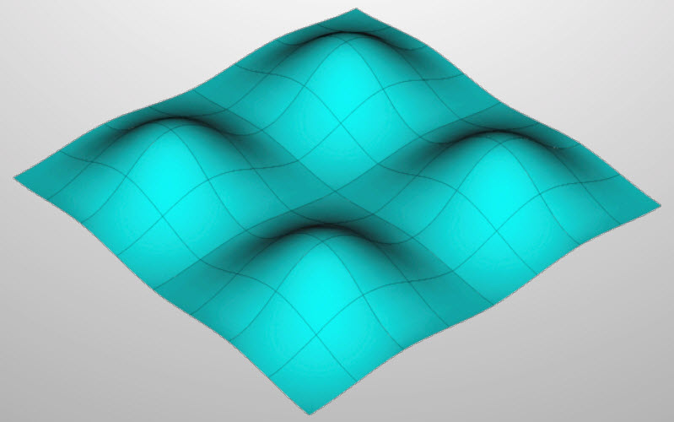
Morse Functions
In the image on the left, the scalar function is height
In our data, the scalar function is point density
Notes:
A Morse function is a smooth, underlying scalar function. In many cases, the space comes equipped with a natural property that can be used as the Morse function. For a landscape such as you see here, we can consider the Morse function to be the height. In the case of our galaxy data, the Morse function is point density (the inverse volume of the voronoi cells).

Slide 29
Critical Points
Maxima
Saddles
Minimum
Notes:
If you imagine placing balls on this hilly landscape, a critical point is a point where you could gingerly place a ball and it would remain at rest. In this 2d surface, the highest points are the local maxima, the lowest points are local minima, and the points which look like a max in one direction, but a min in the other direction are saddles.

Slide 30
Ascending Manifold
Maxima
Saddles
Minimum
Notes:
Consider dropping a ball on this landscape. Many balls would end up in the minimum, while some would fly off the page. The ascending manifold is all the places where you could drop the ball and it would land in a given minimum.

Slide 31
Descending Manifold
Maxima
Saddles
Minimum
Notes:
The descending manifold is defined similarly. All points in the descending manifold originate from one maximum. Later, we will discuss max classes, which you can picture to be a discrete version of this descending manifold pictured here. We will be very interested in the boundary of two neighbouring max classes, since critical points appear on the boundary and these points can give us an indication of whether two mountains are independent or should be merged.

Slide 32

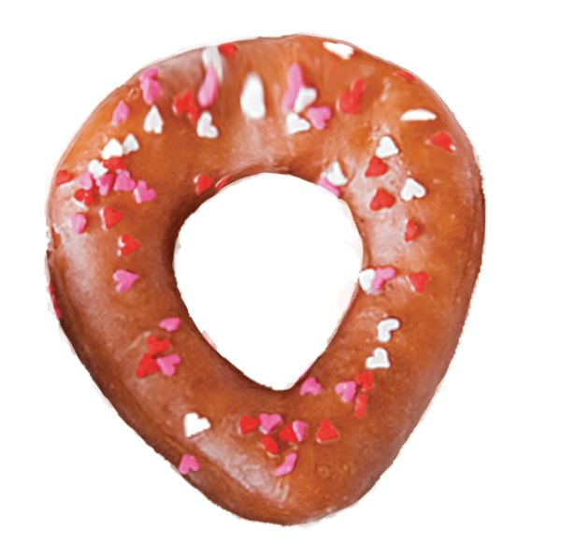
Torus Example
Notes:
Smooth Morse theory helps us identify the shape of space. To illustrate, let’s consider two donuts – one heart-shaped and one round.

Slide 33
Torus Example
Maxima
Saddles
Minima
Notes:
If we stand the donuts upright and imagine pouring chocolate sauce over them, the red maxima are points where the chocolate sauce flows away. The blue minima are places where the chocolate finally gathers and drips off. The green saddles are points where the sauce is flowing towards around the donut and away from along the edge of the donut or vise versa.

Slide 34
Torus Example
Maxima
Saddles
Minima
Notes:
If we stand the donuts upright and imagine pouring chocolate sauce over them, the red maxima are points where the chocolate sauce flows away. The blue minima are places where the chocolate finally gathers and drips off. The green saddles are points where the sauce is flowing towards around the donut and away from along the edge of the donut or vise versa.

Slide 35
Torus Example
Maxima
Saddles
Minima
Notes:
In smooth Morse Theory, we can cancel critical points which have a single chocolate flow line between them.

Slide 36
Torus Example
Maxima
Saddles
Minima
Notes:
In the end, we find that both donuts have the same topology (or rubber shape) – that it’s possible to stretch the heart-shaped donut to match the round one. They both have one donut hole. Since our data is discrete points and not a continuous distribution, we need to look at an alternative to smooth morse theory for discrete data, which Hai will describe for us.

Slide 37
Discrete Morse Theory
Analog to smooth Morse Theory for a discrete point set (Forman 2002)
Works on not smooth, but piecewise linear spaces, e.g. tetrahedra
Notes:
Discrete Morse Theory is the analog to smooth Morse Theory for a discrete point set. It works on piecewise linear spaces such as tetrahedral.

Slide 38
Discrete Morse Theory
Simplices
0-dimensional:
1-dimensional:
2-dimensional:
3-dimensional:
Notes:
Before we can understand DMT, let’s first introduce the concept of simplices

Slide 39
Gradient Paths
Arrows from higher density to lower density
Each simplex has at most one arrow
The Morse function that is used is the density function
The gradient paths sequences of simplices along which density is decreasing
Notes:
Next, we’ll create gradient paths similar to that in smooth Morse Theory

Slide 40
Simplices that are not paired with any other simplex by an arrow are critical
In 2D,
Critical vertices: Minima
Critical edges: Saddles
Critical triangles: Maxima
Notes:
An important

Slide 41
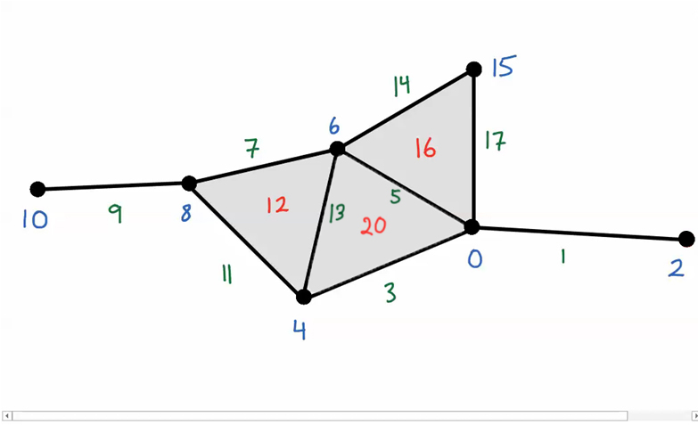
Discrete Morse Theory
Notes:
Let’s see DMT in action. The numbers are the density values of each simplex (the blue are for the vertices, the green are for the edges and the red are for the triangles)

Slide 42
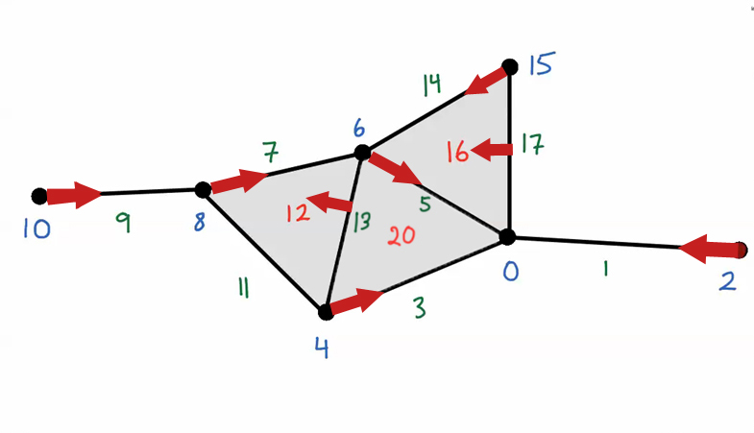
Discrete Morse Theory
Notes:
Gradient paths are created (We pair a lower dimensional simplex with an adjacent higher dimensional simplex if its value is lower)

Slide 43
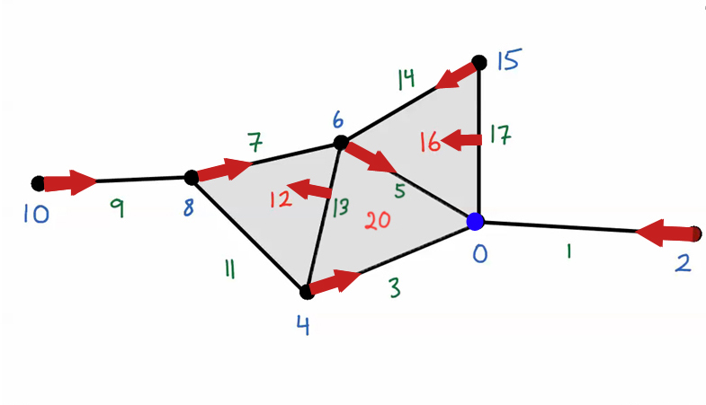
Discrete Morse Theory
Notes:
The blue vertex is not paired with any arrow. It is a minimum

Slide 44
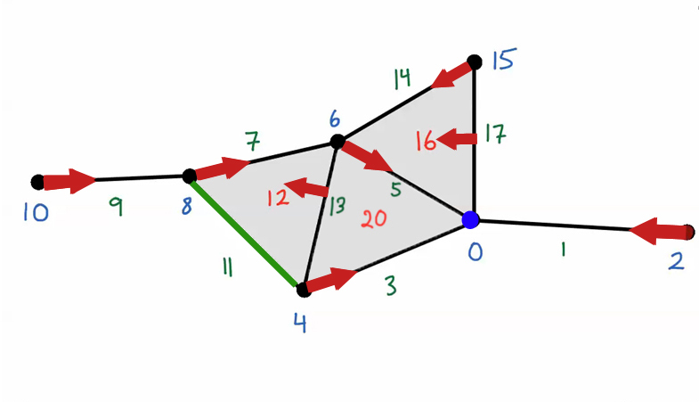
Discrete Morse Theory
Notes:
The green edge is also not paired with any arrow, it’s a saddle

Slide 45
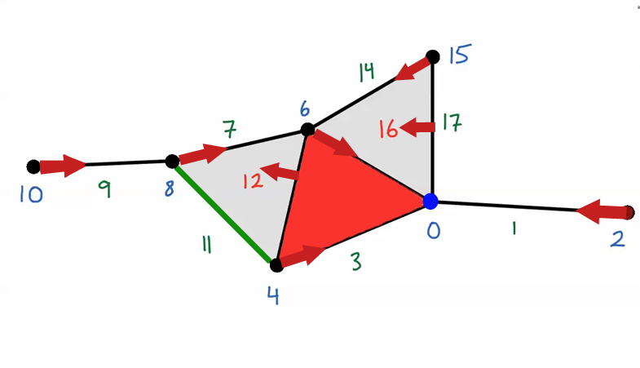
Discrete Morse Theory
Notes:
Similarly, the red triangle is not paired with any arrow, it’s a maximum.

Slide 46
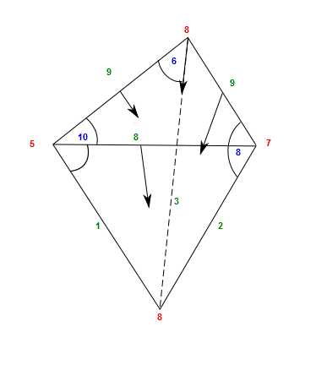
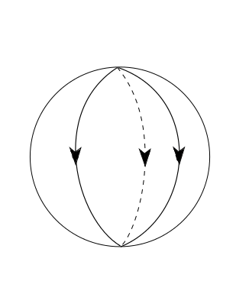
DISCRETE MORSE THEORY
SMOOTH MORSE THEORY
Notes:
The result of DMT is the gradient paths similar that those in smooth Morse Theory discussed before, can be recreated for our discrete nature of our data set

Slide 47
Procedure
Interpolate (Delaunay Tessellation Field Estimator)
Sample a regular grid
Using Attilla Gyulassy’s algorithm,
Compute critical points
Simplify groups
Notes:
In order to implement discrete morse theory on the data set, we first need an underlying scalar function defined everywhere. Point density is only defined at the galaxy points, so we need to interpolate the point density in empty regions. To do this, we use the Delaunay Tessellation Field Estimator, which uses the density defined on the vertices of a Delaunay triangle to interpolate the density within the triangle. The we sample points from a regular grid, and using Attilla Gyulassy’s algorithm, we compute the critical points and simplify groups.

Slide 48
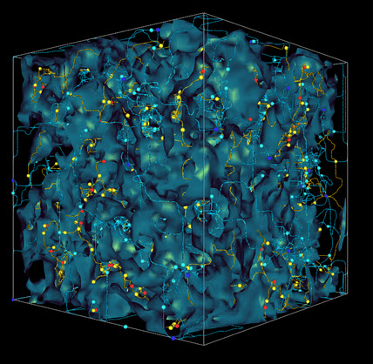
Discrete Morse Theory
Results of applying DMT to our data
Maxima, minima and saddles
Partition of the entire space
Notes:
When we apply Discrete Morse Theory on the Sloan Digital Sky Survey Data, we find the points of maximum density, pictured here as red points. The saddles are yellow and light blue. The minima are dark blue points. The algorithm partitions the data set into ascending and descending manifolds. In the example of the donut, we only had two pairs of critical points to cancel. As you can imagine, the process of cancelling critical points given the complexity of our data in 3d is non-trivial.

Slide 49
Discrete Morse Theory
Advantages
Partitions the data into ascending and descending manifolds, which can be can be of dimension 0, 1, 2 and 3, corresponding to clusters, filaments, walls and voids
Determines the maxima, minima and saddles
Notes:
The advantages of discrete morse theory are that we can partition the data into manifolds and determine all the critical points.

Slide 50
Challenges in Implementation
Need to assume an underlying smooth function
Critical points are from sampled interpolation and are not points in the data set
Simplifying groups is computationally challenging
Notes:
DMT assumes that there is an underlying smooth function and structures. Critical points are on the grid, not in the data set
With these challenges in mind, our goal in this project is to find an algorithm which computes critical points, partitions the space into groups, and classifies the groups in a way that is computationally efficient. For that purpose, we turned to a well-known algorithm in cluster-finding, HOP, which Joey and Matthew will explain.

Slide 51
HOP and Variants

Slide 52
HOP
HOP is a simple algorithm for grouping data points and observing potential structure in our galaxy data
Formulated by Eisenstein and Hut in 1997
Notes:
NOTE: We are not using the complete Eisenstein and Hut proces

Slide 53
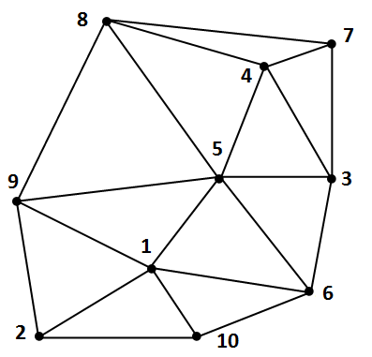
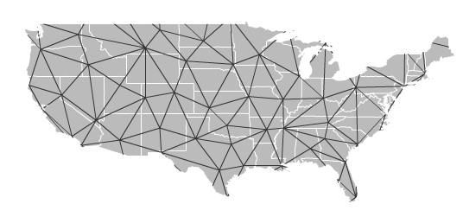
What HOP needs to work
Any set of vertices with neighbor (edge) information and an applicably one-to-one scalar function on every vertex

Slide 54
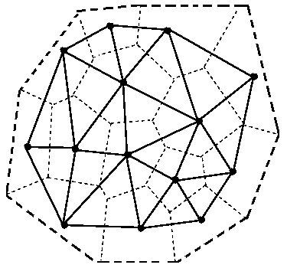
Our Neighbor Choice
Delaunay Triangulation
Simple connections based on local geometry
Notes:
Delaunay Triangulation
Simple connections based on local geometry
Our Density Function
We chose 1/Voronoi Volume
A logical representation of local density
“Reasonably” one-to-one function

Slide 55
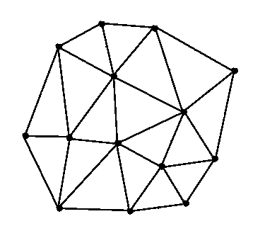
Our Neighbor Choice
Delaunay Triangulation
Simple connections based on local geometry
Notes:
Delaunay Triangulation
Simple connections based on local geometry
Our Density Function
We chose 1/Voronoi Volume
A logical representation of local density
“Reasonably” one-to-one function

Slide 56
Our Density Function
$ρ=\frac{1}{Voronoi Volume}$
Logical representation of local density
Effectively one-to-one
Notes:
Delaunay Triangulation
Simple connections based on local geometry
Our Density Function
We chose 1/Voronoi Volume
A logical representation of local density
“Reasonably” one-to-one function

Slide 57
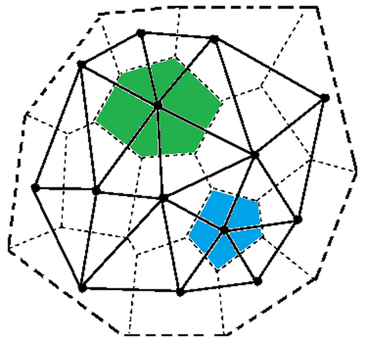
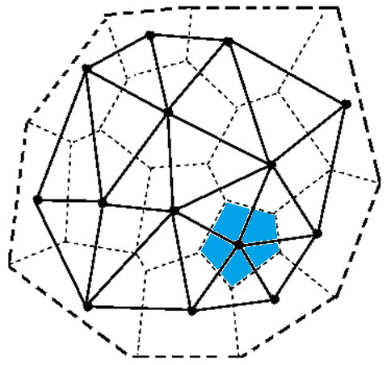

Our Density Function
$ρ=\frac{1}{Voronoi Volume}$
Logical representation of local density
Effectively one-to-one
Notes:
Delaunay Triangulation
Simple connections based on local geometry
Our Density Function
We chose 1/Voronoi Volume
A logical representation of local density
“Reasonably” one-to-one function

Slide 58
The HOP Process
Start from any vertex
Consider all neighboring points of the chosen vertex
Find the highest-valued neighbor and HOP to that vertex
Notes:
4.7” 5.04”

Slide 59
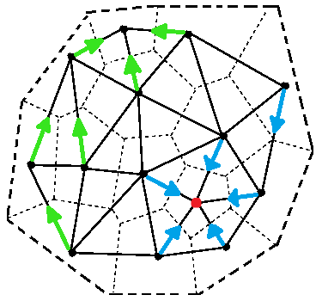
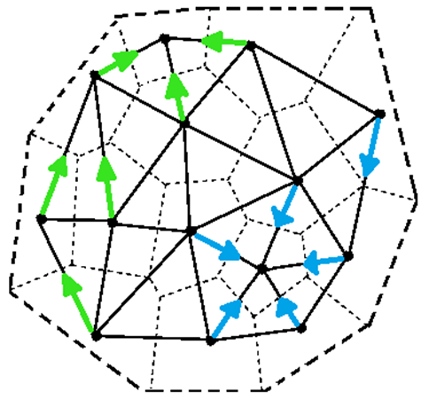
What does HOP give us?

Slide 60
What does HOP give us?
Maxima

Slide 61
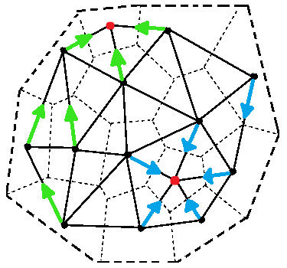
What does HOP give us?
Maxima =
Points which are higher-valued than all of their neighbors; i.e. the termination of any HOP path

Slide 62
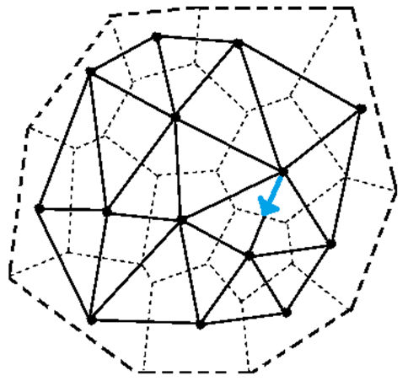
What does HOP give us?
HOP Paths

Slide 63
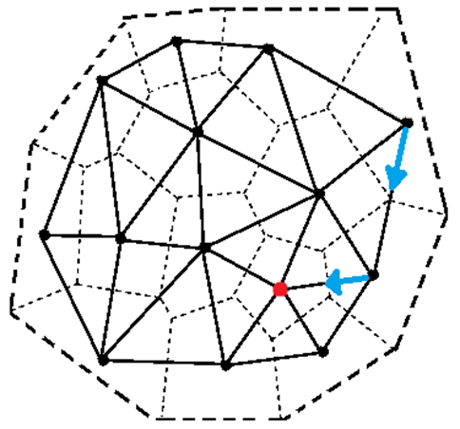
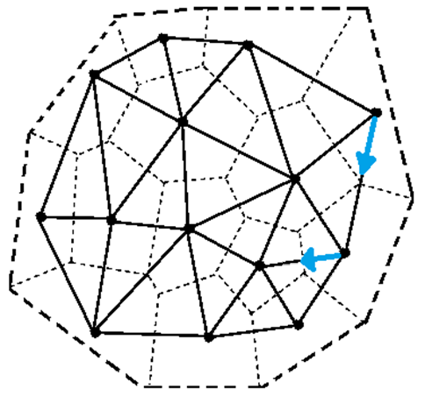
What does HOP give us?
HOP Paths =
Any chain of HOP arrows that indicate a flow from low density to high density

Slide 64
What does HOP give us?
Max Classes

Slide 65
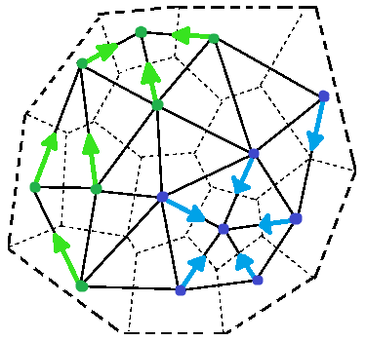
What does HOP give us?
Max Classes =
A set of vertices who all HOP to the same maximum (including the maximum itself)

Slide 66
What does HOP give us?
Boundary points

Slide 67
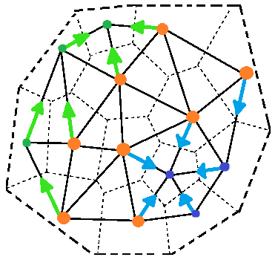
What does HOP give us?
Boundary points =
Points on the edge of a max class
Representative of separation between 2 max classes

Slide 68
What does HOP give us?
Bond Edges =
Notes:
Demonstrates the connection between max classes

Slide 69

What does HOP give us?
Bond Edges =
Edges between 2 points on different boundaries (i.e. in 2 different max classes)
Notes:
Hop - ?

Slide 70

HOP on a slice
Notes:
Colored to partition the data
Maxes are circled
Each color refers to a specific max class.
Due to the simplicity of HOP, we had some ideas for some variations
About 15 max classes

Slide 71
Variant: EHOP
1. From any vertex, you consider its neighbors and its neighbors’ neighbors
2. HOP to the highest-valued neighbor
Notes:
We add an elbow to hop. That is, from one vertex, we are now allowed to HOP to another point up two neighbors away. With an elbow in between.
The way EHOP works in this diagram is to start with a point
Normally we would HOP to this point. In EHOP, we also consider the neighbors of the neighbors.
The point will then HOP to the highest density vertex in its extended range.

Slide 72

Variant: EHOP
Notes:
Here’s what it looks like if we performed the EHOP process on our data slice
Like HOP we get all the same types of information (Max, Max classes, boundary points, etc)
Notice that there are fewer colored regions, or fewer unique max classes

Slide 73
Variant: EHOP
Differences:
Adds more HOP neighbors for each point
Addresses the extreme local nature of the vanilla HOP
Reduces the number of max classes
HOP
EHOP
Notes:
This is because in original HOP (vanilla), each point considers only its neighbors to hop to, making it a very local process
The added choices for each HOP path in EHOP addresses this locality issue and smoothes our data giving a different perception of its shape or topology

Slide 74
Variant: Smooth Hop
New Density function
$$ρ\left(p\right)=\frac{1+k}{V\left(p\right)+\sum_{i}{V(n_{i})}}$$
This effectively smooths the original density function.
Density function closer to the physical definition of density
$$ρ\left(p\right)=\frac{mass}{volume}$$
Notes:
--Another way we tried to smooth our data was to change our density function
Our new density is listed on the screen and was motivated by the fact that we wanted to incorporate information from a point’s density and its neighbors’ densities.
We wanted to create an “average” density of each point’s local region to smooth small fluctuations from point to point.
While the formula on the screen looks strange, it simply is a function closer to the Phys Def…
Recall that in our data set, the mass for each point is one

Slide 75

Variant: Smooth Hop
New Density function
$$ρ\left(p\right)=\frac{1+k}{V\left(p\right)+\sum_{i}{V(n_{i})}}$$
Notes:
--Another way we tried to smooth our data was to change our density function
Our new density is listed on the screen and was motivated by the fact that we wanted to incorporate information from a point’s density and its neighbors’ densities.
We wanted to create an “average” density of each point’s local region to smooth small fluctuations from point to point.
While the formula on the screen looks strange, it simply is a function closer to the Phys Def…
Recall that in our data set, the mass for each point is one

Slide 76

Variant: Smooth HOP
Notes:
When we applied this to hop, it made a dramatic difference in the number of maxes and max classes.
- This indicates that a simple difference of the density function can make significant changes in the results of HOP

Slide 77
Variant: Smooth HOP
Differences from HOP:
Revised density function to smooth data
Reduces the number of max classes in the result
Gives different maxes than HOP
HOP
Smooth HOP
Notes:
In addition, changing the density function actually changed some of the locations for our maxes.
In the boxes if you look carefully, Smooth HOP yielded a max that was not considered a max in vanilla HOP
This once again indicates that the topology of our dataspace has changed

Slide 78
Variant: JHOP
1. Triangle Max Class
Triangles are assigned to the max class of their densest neighbor
Notes:
We also played around with the idea of fitting HOP to our needs. That is, using HOP to resemble Discrete Morse Theory
Joey created an add-on to HOP that gives us a little more information using HOP and may even give us critical points like Saddles and minima.

Slide 79

Variant: JHOP
1. Triangle Max Class
Triangles are assigned to the max class of their densest neighbor

Slide 80
Variant: JHOP
2. Gradient Vectors
An arrow (vector) is assigned to each triangle of the tessellation
The vector points to the triangle’s densest point and away from the face opposite the densest point
Notes:
CHANGE THE PICTURE!!!!!!! One without arrows

Slide 81
Variant: JHOP
3. Critical Simplices
A critical simplex is an edge that has two gradient vectors coming out of it
These edges separate max classes

Slide 82

JHOP on a slice

Slide 83
Variant: JHOP
Additions to HOP:
Gradient vectors to determine triangle max classes
Triangle max classes partition entire data space
Provides critical simplex information
HOP
JHOP

Slide 84
Benefits of HOP
- HOP is a very simple algorithm
- Easy to compute
- Allows room for pre-/ post-processing
- Guaranteed, unique convergence
- Algorithm can be reversed
- Parameter-free
- Can be generalized to any dimension
Notes:
Our use of HOP doesn’t have much more to it than what we were able to explain in a few minutes
It was very easy to program. I learned MATLAB this semester I was able to write the script to apply HOP to our data set
There are a lot of options for varying HOP to suit different purposes.
In addition, we can perform some post-processing to help understand our data. We’ll be going over this in just a bit.
Due to the fact that each point hops to higher density points, it is always ascending into a max. thus, the algorithm terminates which is useful computationally and
ASK JEFF FOR INFORMATION

Slide 85
Drawbacks
- Extremely local - sensitive to small outliers in data
- Results are sensitive to the choice of density function
- Extremely dependent on initial neighboring information ~ can lead to unintuitive max classes
Notes:
Since each point can only HOP to one of its neighbors, the algorithm is very local
This means that there are many maxes that only happen to be marginally larger than its neighbors.
In Smooth HOP, a new density function changed our results dramatically.
Change our neighboring information can radically change the results. There are also some notable local situations where a point looks like it would HOP to a point very close to it, but would HOP across a void-like region simply because of this neighbor information.
David will elaborate further on this.

Slide 86
Morse Theory-HOP Bridge
Notes:
Now that we have the tool for partitioning our data into disjoint sets, we may ask if this tool also accomplishes something in the essence of Morse theory.
At first glance, this appears to be true, since each of our max classes is disjoint, and between our max classes, there’s a definition that we can introduce which we can then think of as corresponding to the boundaries of the ascending (or descending) manifolds of Morse theory.
But wait!
Since the classic, or standard, HOP algorithm hops from vertices to vertices via edges of Delaunay triangles, will our definition of the boundary even make sense?

Slide 87
Boundary (Standard Definition)
Notes:
As a reminder of how we normally expect boundaries to look like, suppose we have a filled-in solid square, and tessellate it by drawing (CLICK) one diagonal line between opposite vertices.
The boundary of the square is then just the (CLICK) four vertices and edges on the outside.
While, if we have some object that resembles (CLICK) a hollow hexagon, a hexagon without the inside part, just the edges, and we tessellate it trivially by drawing straight lines (CLICK) over each of the edges of the hexagon, there is no boundary.
But, for the hexagon, if we are to remove an edge, say, (CLICK) the bottom one, then (CLICK) retessellate it, all of a sudden, we get (CLICK) a boundary, of two vertices.
Notice that a key feature here is that for an n-dimensional object, we expect to get out an (n-1)-dimensional object as boundary.
For example, for the 2-dimensional square, we get 1-dimensional boundary, edges.
Here, we are ignoring the vertices, since they are a part of the edges.
And for the incomplete hollow hexagon, which is 1-dimensional, our boundary is vertices, which are 0-dimensional.
So, this sets a rubric to check if the boundaries we define for max classes make sense.

Slide 88
Dimensional HOP
Notes:
Suppose that we are naïve, and believe that the boundary of a max class should be the set of (CLICK) starting vertices of all of the HOP paths that end at a common maximum.
Or, maybe, the boundary edges (CLICK), the edges that connect among the boundary vertices.
Or, maybe, have the (CLICK) bond edges thrown in (CLICK) for good measure, because why not.

Slide 89
Dimensional HOP
Notes:
In all of these, our boundary is either 0-dimensional (CLICK) when using only the boundary points, it is disconnected (CLICK) when we have boundary edges alone, or it’s (CLICK) some-ugly-thing-that-we-don’t-have-a-name-for that we don’t know what its dimension should be, and doesn’t look to play nicely.
Rather than spending the entire semester, and maybe then some, to keep trying to figure out an appropriate definition for the boundary in classic HOP when we are trying to obtain results similar to Morse theory, we’ll just abandon it, because difficult problems are... difficult, and I'm not a masochist. I'd rather turn on the cruise control. In fact, I'd rather let someone else drive, but, we’re stuck with me, like I am.

Slide 90
Dimensional HOP
Observation: Two neighboring simplices of the same dimension in a Delaunay tessellation must intersect at a face of one lower dimension
Notes:
Anyways, there is actually an easy approach that avoids the entire issue of how we can define it so that very little ambiguities occur, so easy that it can almost be seen as an elegant solution.
Rather than hopping on vertices, where neighbor relationships are defined by the edges of Delaunay triangles, we’ll just hop on those Delaunay triangles directly.
First though, here’s an observation.
Suppose we have a Delaunay tessellation, and we pick any two neighboring simplices of the same dimension.
They must then intersect at an (n-1)-dimensional simplex that also belongs to our original Delaunay tessellation.
In fact, this can be generalized to tessellations by arbitrary polyhedra, but that’s an aside.
Armed with this observation,

Slide 91
Dimensional HOP
Notes:
let’s perform HOP, in R^2, on the Delaunay triangles.
Let’s take (CLICK) two neighboring max classes (CLICK).
Suppose we pick two triangles, one from each max class.
By the observation, either they must be (CLICK) disjoint, which is uninteresting because they are not neighbors, or (CLICK) they must intersect at a 1-dimensional (CLICK) simplex, which is a Delaunay edge.
If we perform this process of picking one triangle from each of two neighboring max classes, intersect them, and keep the edge intersections (CLICK), we can then define this to be the boundary (along with (CLICK) the boundary of data space, of course).
This then matches our goal of wanting one less dimension on the boundary.
For example, here, we HOP on the triangles, which are 2-dimensional, and we end up with 1-dimensional edges as the boundary.
There is a small complication that we need to be aware of, however.
When we have two or more classes neighboring each other, the boundary is pretty easy to find.
We just take the neighboring classes, then intersect them.

Slide 92
Dimensional HOP
Notes:
But when we only have one class (CLICK) by itself, we have no consistent way of finding the “boundary.”
This is still yet to be resolved.

Slide 93
Dimensional HOP
Notes:
Taking a step back though, there’s no reason why we cannot generalize this to n-dimensions, as well as all complete subsets of the Delaunay tessellation of intermediate dimensions that we’ve been hinting at.
In particular, continuing the example, there’s absolutely nothing stopping us from hopping on this boundary we obtained!
Assuming the boundary of the data space doesn’t exist, for simplicity.
If we HOP on this set, and obtain (CLICK) these classes, we can see that their intersection is (CLICK) a point, which is exactly what we expect by the proposition, for the intersection of neighboring classes to be of one lower dimension, in this case, 0.
For consistency though, we will need to include the actual boundary of the data space when we perform HOP on the boundaries, here, it’s just the outer edges that we need to include.

Slide 94
321-HOP
Tessellate data in $ℝ^{3}$ using tetrahedra
HOP on tetrahedra (maxima)
Determine triangle boundaries
HOP on triangles (2-saddles)
Determine edge boundaries
HOP on edges (1-saddles)
Determine vertex boundaries (minima)
Notes:
For our 3-dimensional SDSS data set, we perform HOP on the 3-dimensional Delaunay tetrahedra, whose maxima are, of course, tetrahedra (that we call the maxima of the data space).
The boundary is then a complete subset of the Delaunay tessellation formed of triangles only.
We then HOP on that set, obtaining triangles as maxima (that we call 2-saddles) and edges as its boundary.
Hopping on the set of edges, its maxima are called 1-saddles, and then, we finally obtain vertices as the 0-dimensional boundary, corresponding to minima.
Applying this to our slice of the SDSS data, slice implying that it’s 2-dimensional rather than 3,

Slide 95







321-HOP
Notes:
after we Delaunay tessellate it, we first HOP on the full set of triangles, to obtain (CLICK) these classes with the white triangles (CLICK) as the maxima.
Then, we determine its boundary (CLICK) by checking for the edges common to two triangle classes, and including the boundary of data space.
Afterwards, we can HOP on this set of edges, and obtain (CLICK) these as the classes, with the white edges here (CLICK) as the maxima of this set, which really should be called saddles.
Lastly, we can find the boundary (CLICK) of this set, corresponding to minima.
Unfortunately, not all of them are plotted here due to the issue we’ve yet to work out.
And now we have rediscovered how to make stained glass!
Regarding the name we came up with, it refers to how we are hopping in descending dimensions, and that our data set is 3-dimensional.
The 0 is not included, since the 0-dimensional points are trivially their own max classes in general.
The term “dimensional HOP” was just trying to hint that we want to incorporate hopping on various dimensions, not because we have discovered how I can flatten myself down to a piece of paper while still retaining my personal identity.
To be more precise though, we should have called it something like HOP in descending dimensions, since this is clearly not restricted to 3-d, but this was the name that stuck.

Slide 96
321-HOP
Benefits
Compares well to Morse theory
Natural, well-behaved boundary
Drawbacks
Inherited from HOP
Complexity of cancelling critical points*
*Huge bounty**
**In Monopoly money
Notes:
This compares favorably to Morse theory, since, here, in n-dimensional space, the critical simplices have the same dimensions as the indices of critical points assumed in Morse theory.
Compared to classic HOP, this procedure has very natural and quite well-behaved boundary.
However, since this only changes the objects HOP operates on, every drawback we experienced makes an appearance here as well.
Now, since its goal is to emulate Morse theory, the next logical step is to devise a scheme for the cancellation of critical points.
This problem is highly nontrivial, and, in fact, we believe it to be at least as complex as DMT.
By the way, we are offering a bounty of 10 million dollars to anyone who solves it.
Monopoly money.
We have been quite focused on individual approaches, so here’s a brief meta-analysis of the ones we examined.

Slide 97
Goals
We want to find structures in the galaxy distribution
Partition the space
Grouping
Classification of structures
a. Clusters b. Filaments c. Voids
Notes:
Ultimately, our goal is to identify structures in the galaxy distribution. First, we need to partition the space, then group structures, and classify them. Galaxies tend to group together and form clusters. When viewed from a distance, giant clusters of galaxies appear as bright points in our data. There are also more extended structures such as filaments and walls. Filaments are primarily 1d – long and tubular structures. Walls are like sheets of galaxies, forming 2d structures. The large, mostly empty regions are termed “voids”.

Slide 98
Raw Data Points
Partitions the data space and provides neighboring information.
Voronoi/Delaunay
Finds the local maximum (or minimum)
density galaxies and partitions the data points into max classes.
HOP

Slide 99

Raw Data

Slide 100

Raw Data
Delaunay

Slide 101

Raw Data
Delaunay
HOP
Local maximum density points are shown in red.
Notes:
HOP converges to the maximum density data points.
The triangles can distract us from the point of HOP so let’s remove them.

Slide 102

Raw data with HOP maxima

Slide 103

HOP minima from reverse HOP
(HOP toward decreasing density)

Slide 104
Clusters and voids are may be found using HOP maxima and minima.
Notes:
It is clear that many HOP maximums occur in the cluster regions of high density, and there are very few maximums in the void regions. Now, it is not too difficult to find the clusters and voids but the challenge is in identifying filamentary structures.

Slide 105
Connecting neighboring maxima could reveal filamentary structures
Notes:
But notice that we get HOP maximums in areas that seem filamentary. It appears that if we could simply connect the dots correctly we might be able to string together maxima into a chain along the filaments.

Slide 106

A close-up of two neighboring max classes
Notes:
Here is a close-up of two neighboring max classes. To connect neighboring maximums we define a metric that on the set of maximums that measures “how far apart they are.” From this metric we get geodesics, which are simply the shortest paths from max to max in a certain sense. I will skip the technicalities of these definitions and instead show you a shortest path.

Slide 107

HOP Geodesic
The HOP geodesic path connecting neighboring maxima.

Slide 108

Plotting the geodesics that connect neighboring maxima
(from shortest to longest)

Slide 109

Geodesics in 3D

Slide 110


Slide 111


Slide 112


Slide 113


Slide 114


Slide 115

$α$ - Shapes

Slide 116

$α$ - Shapes
To make an
$α$-shape, we
begin with a Voronoi Tessellation.

Slide 117

$α$ - Shapes
The blue volume is an example of a Voronoi cell.
In a Delaunay triangulation, neighbors with a shared wall automatically have their data points connected by a line segment (1-cell) no matter how far apart they are.

Slide 118
$α$ - Shapes
Start with a Voronoi cell (blue area) and the representative data point (red dot).

Slide 119

$α$ - Shapes
Start with a Voronoi cell (blue area) and the representative data point (red dot).
Create a disk of radius, $α$, centered at the data point in the Voronoi cell (yellow disk).
$α$ - Shape:
Intersection of Voronoi cell and disk of radius $α$.

Slide 120
$α$ - Shapes
The resulting intersection is the $α$-shape
(shown in green).
We use $α$-shapes to build an $α$-complex.

Slide 121

$α$ - Shapes
When the radius, $α$, is large enough, neighboring
$α$-shapes have intersecting boundaries (the blue arrow).
When two neighboring $α$-shapes intersect, we connect the data points with an edge (1-cell shown in red).
In green, we see a boundary that the
$α$-shape doesn’t reach.

Slide 122

$α$ - Shapes
When three
$α$-shapes share a point on their boundary, we fill in the triangle
(2-cell).
Larger $α$, produces more connections.
This generalizes to three dimensions where we will get tetrahedra as well.

Slide 123

$α$ - Complex Example
We begin with a set of points
(a point cloud).

Slide 124

$α$ - Complex Example
We create the Voronoi Tessellation for the point data.

Slide 125

$α$ - Complex Example
Then we set a value of $α$(same for all Voronoi cells).
Connect the data points with the appropriate edges and/or triangles.

Slide 126

$α$ - Complex Example
As $α$ increases, more connections are made.

Slide 127

$α$ - Complex Example
Larger values of
$α$make more connections over larger distances.

Slide 128

$α$ - Complex Example
Finally, if we allow $α$ $→∞$,
we recover the full Delaunay triangulation.

Slide 129
$α$ - Complex Example
Original raw data.

Slide 130

$α$ - Complex Example
An $α$-complex for a particular value of $α$.

Slide 132


Slide 133


Slide 134


Slide 135


Slide 136


Slide 137


Slide 138


Slide 139


Slide 140

Varying $α$ produces a spectrum of complexes
Small $α$ reveals small structures
As $α$ increases, larger structures are revealed

Slide 141
Edges from the full Delaunay triangulation

Slide 142

Edges in an $α$-complex

Slide 143

Maxima from HOP on this $α$-complex

Slide 144

Maxima with raw data

Slide 145

All geodesics in the $α$-complex

Slide 146

All geodesics in the complete Delaunay

Slide 147

All geodesics in a particular $α$-complex

Slide 150
Raw Data
Delaunay
$α$-complex
HOP
Geodesics
Connecting
Neighboring
Max-classes
Classification of structures?

Slide 151
The maxima with geodesics is a planar graph

Slide 152

Clusters have maxima that are connected to all of their neighbors.

Slide 153

In filamentary regions maxima are connected to only some of their neighbors.

Slide 154
Raw Data
Voronoi/Delaunay
$α$-complex
HOP
Geodesics
Connecting
Neighboring
Max-classes
Classification of structures?

Slide 155
Where do we go from here?

Slide 156
Alpha Shapes – HOP – Geodesics
Benefits:
Computationally efficient
Visual and intuitive appeal
Potential filament finder
Drawbacks:
Inherits several of the drawbacks of HOP
Notes:
This approach combines two well-known computational topology algorithms -- HOP & alpha-shapes -- along with the novel notion of geodesics on HOP Max Classes. In doing so, we provide a computationally efficient generative model for the geometric topology of galactic point cloud data, that seem to correspond to existing research on the topology of real and simulated data on the formation of the cosmic web. In addition, the results of our approach have much visual and intuitive appeal and have potential to identify filaments. However, since the procedure uses HOP, we also inherit the drawbacks of the HOP algorithm. So how can we proceed from here and identify structures?

Slide 157

Combinatorial Codes
Assign a code to each galaxy based on how many tetrahedra, triangles, and edges are connected to it at a range of $α$.
Use the codes to identify whether the galaxy lives in a cluster, filament, or void
Notes:
One speculative approach we’ve considered recently is to assign a code to each galaxy based on how many tetrahedral, triangles, and edges are connected to that galaxy as we vary alpha in the alpha complex. We could then use the codes to identify whether the galaxy lives in a cluster, filament, or void.

Slide 158




$$\left(\#triangles, \#edges\right)$$
$$\left(0,0\right)$$
$$\left(0,0\right)$$
$$\left(0,0\right)$$
Notes:
Let me illustrate with a particular example. We start with alpha equal to zero. The coordinates represent the number of triangles and edges connected to each galaxy. For the three galaxies here, when we begin, each has no simplices attached to it, so is given a code of (0,0)

Slide 159




$$\left(\#triangles, \#edges\right)$$
$$\left(0,1\right)$$
$$\left(1,2\right)$$
$$\left(1,3\right)$$
Notes:
As alpha increases, more simplices in the alpha complex are included, so the codes change. The galaxy on the left has one triangle attached and two edges, so it has a code of (1,2)

Slide 160




$$\left(\#triangles, \#edges\right)$$
$$\left(0,1\right)$$
$$\left(7,7\right)$$
$$\left(2,3\right)$$
Notes:
When we change alpha again, suddenly the galaxy on the right is completely surrounded. From now on, its code will be (7,7) since it is completely surrounded by triangles. A code that completes early in the alpha complex could represent a point in a cluster.

Slide 161




$$\left(\#triangles, \#edges\right)$$
$$\left(1,3\right)$$
$$\left(7,7\right)$$
$$\left(4,5\right)$$

Slide 162




$$\left(\#triangles, \#edges\right)$$
$$\left(4,5\right)$$
$$\left(5,6\right)$$
$$\left(7,7\right)$$
Notes:
Some codes might stay at one value for an extended time. The galaxy on the left remains at (5,6) for some time. We may be able to use this persistent code to establish whether the galaxy lives on a filament or a cluster.

Slide 163




$$\left(\#triangles, \#edges\right)$$
$$\left(4,5\right)$$
$$\left(7,7\right)$$
$$\left(5,6\right)$$

Slide 164



$$\left(\#triangles, \#edges\right)$$
$$\left(6,7\right)$$
$$\left(7,7\right)$$
$$\left(5,6\right)$$

Slide 165



$$\left(\#triangles, \#edges\right)$$
$$\left(7,7\right)$$
$$\left(7,7\right)$$
$$\left(7,7\right)$$
Notes:
Eventually all the galaxies are surrounded by triangles as alpha gets larger. We could use the persistent codes to determine which structures the galaxies live on.

Slide 166
Compare Algorithms
Find a framework to comparatively analyze the outputs of HOP, Discrete Morse Theory, 321-HOP, and geodesics
Notes:
We could also find a way to compare and contrast the various algorithms to evaluate their output in a meaningful way.

Slide 167
Apply algorithms to more data
Test algorithms against
Simulations of the evolution of the galactic distribution
Other sky surveys with more data points
Notes:
We could also try other established algorithms and methods in the field of topological data analysis.
In conclusion, we have discovered a truly marvellous way to classify galaxies, which the margin of this slide is too narrow to contain. We leave the problem as an exercise for the audience. Thank you.

Slide 168
Acknowledgements
We would like to thank the following people for their support in our research
Attilla Gyulassy, LLNL
Timo Bremer, LLNL
Gunnar Carlson, Stanford
Thierry Sousbie, University of Tokyo
Notes:
We could also try other established algorithms and methods in the field of topological data analysis.
In conclusion, we have discovered a truly marvellous way to classify galaxies, which the margin of this slide is too narrow to contain. We leave the problem as an exercise for the audience. Thank you.

Slide 169
Lunch: Flames Eatery, 88 S. 4th Street

